Slide 1

Earn
with
Eiman.

Slide 2
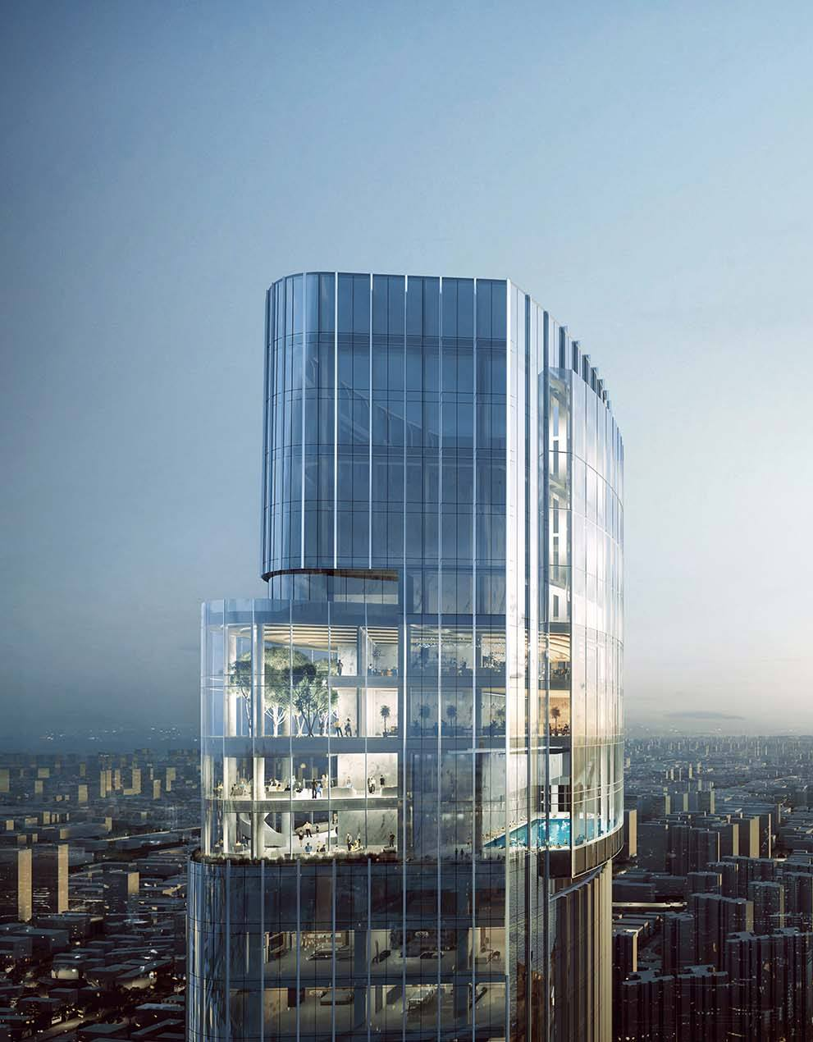

Eiman Estates Ltd. is a
Real Estate Developer with a mission to create ethical income
opportunities for the county’s young generation.

Slide 3


Now you can have an exciting
independent profession being an
Equity Partner
of Velora Inani, the first-of-its-kind Lifestyle Hotel Project of Eiman Estates Ltd. to be built in Inani, Cox’s Bazar.

Slide 4
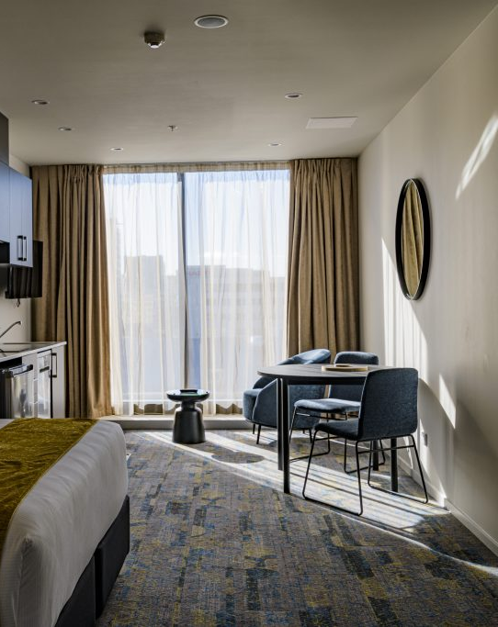
1. Own a hotel unit paying 15 Lac Taka
2. Be a Registered Equity Partner yourself
3. Start Selling Shares to bring in Shareholders*
(Each hotel unit may have max 30 shareholders)

Slide 5

How an Equity Partner earns
1. Room Rent
2. Food & Beverage
3. Events
5. Others

Slide 6

Projected Return on Investment
55 Lac Taka*
(subject to the hotel’s performance, profitability,
and operational costs)

Slide 7

Secured & Protected
Registered Agreement
Annual Owners’ Meeting
Audited Annual Statement

Slide 8

Welcome onboard.
Call: +8801335086800
Drop by: Rupsha Tower, Floor 10,
Plot 7, Road 17, Banani, Dhaka, Bangladesh 1213
Mail: info@eimanestates.com
Visit: www.eimanestates.com

